Slide 1
Design:Advanced

Slide 2
DeSIGN - Advanced
Program flow
1. Activity – Share a non-technical case study which shows impacts due to neglect of overall picture //15 min icebreaker
2. Component design basics // 30 min
Definition, characteristics
Ways to approach design of a components – various views – functional view*, deployment view, non-functional attribute view (perspective of HA, performance, maintainability etc)
3. Discuss case study which was shared earlier // 30 min
- Identify key takeaways and issues in the case study.
- Discuss the feature enhancement requirements sought in the case study
- Lead the discussion to component design approach, as listed in point 1.
4. Functional view // 30 min
*The functional view can be replaced by Object view for batches who have worked on OOD.
- separation of concerns, interfaces
- cohesion and coupling, dependencies
- Sequence flows
- Discuss example
5. Non-functional attribute view // 2 hours
For each attribute(HA, performance/concurrency/multi-core, maintainability/heterogeneity, fault tolerance, deployability)
- discuss the theme and basics around it. (e.g. for HA, discuss 5 9s, Carrier grade requirements etc)
- discuss relevant tactics/patterns (e.g. for HA, we have tactics for Fault detection, recovery and prevention)
- take one small specific example to walk through
6. Team activity // Total 2 hours
- Provide enhancement requirements for each attribute.
- Divide participants into teams. Each team to work on one attribute.
- Each team has to discuss and present design approach for given attribute.
6. Summarize
Notes:
10 minutes:
Discuss the definition of design
Wikipedia says “Software design is the process by which an agent creates a specification of a software artifact, intended to accomplish goals, using a set of primitive components and subject to constraints”.
It is the blueprint of how a software needs to be implemented.
Encourage the participants to discuss what happens if we don’t have a design phase and get into coding straight away.
For small activities like Coding a search algorithm, it may be easy to code directly, but if you want to implement a larger system, while making sure that all its requirements are satisfied (and that others are ok with your approach), it makes more sense to make a design document first.
Design helps organize your thought process before coding.

Slide 3
DeSIGN - advanced
Design - Foundation
To be able to design a small component
Applying principles of modularity, abstraction, information hiding
To be able to refactor a piece of low level design & improve cohesion

Slide 4
DeSIGN - Advanced
Design - Proficient
To be able to design a small network of sub-components
To be able to apply multi-threading and portability concepts

Slide 5
DeSIGN - Advanced
Advanced Objectives
Able to design for a major Component of the overall system. eg: O&M component
Able to tune the design for a multi-core architecture
Defining the performance parameters,
Implementing design the service attributes like concurrency, availability, fault tolerance etc

Slide 6
DeSIGN - Advanced
First, a small activity
Form groups of 2
Design a trash bin
You have 5 minutes to draw one
Notes:
5 min to design on post-its.
Stick them on the whiteboard. Ask ppl to tick and give votes.
Different conflicting options would be there. Open/closed, big/small, light/heavyduty.
Takeaway - Design is the skill to tradeoff. Great designers know and try to balance best.
Give a gift to the most innovative design.
A simpler option is to draw a tree. Very few will draw roots too.
http://wirfs-brock.com/blog/tag/icebreaker/
Why did you draw the way you did.
Why did or didn’t you draw the roots?

Slide 7
DeSIGN - Advanced
What is a component?
“A modular, deployable, and replaceable part of a system that encapsulates implementation and exposes a set of interfaces.”
— OMG UML Specification

Slide 8
DeSIGN - Advanced
Component level design
Component-level design defines the data structures, algorithms, interface characteristics, and communication mechanisms allocated to each component
Functional view
View for each quality attribute
Availability
Performance
Deployment
Maintainability
Produce sufficient details for Detailed Design to take place.

Slide 9
DeSIGN - Advanced
Functional view
The functional view allows you to summarize what the key functions of the system are and how the various sub-functionalities are linked.
A functional view should answer the following types of questions.
Is it clear what the component actually does?
Is it clear which features/functions/use cases are most important?
Is it clear who the key functional users are (roles, actors, etc) and how the component caters for their needs?

Slide 10
DeSIGN - Advanced
Common areas of focus
Separation of concerns, interfaces
Cohesion and coupling, dependencies
Sequence flows

Slide 11
DeSIGN - Advanced
Functional view – structured approach
Top down design
Use Data Flow Diagrams (DFDs)
Apply modularity principles (cohesion, coupling)
Sufficiently small modules can be used as functions which can be coded

Slide 12
DeSIGN - Advanced
Functional design – OO approach
Identify design classes in problem domain/decompose into sub component
Elaborate design of communication interface
Describe persistent data sources
Elaborate behavioral representations
Elaborate deployment diagrams
Refactor design and consider alternatives

Slide 13

DeSIGN - Advanced
Exercise
For given partially filled design document
Identify the main sub-components basis the functionality likely to be exhibited
Notes:
Case :
FTP Server – given a set of broad requirements, identify the main sub-components.

Slide 14
DeSIGN - Advanced
Non- functional attributes
Let us look at each non-functional attribute from the perspective of design

Slide 15
DeSIGN - Advanced
Availability
System should always provide service
‘Availability’
Committed uptime of 1 – 10^{-n} is called ‘n-nines’
‘Five nines’ ≡ 99.999% uptime
‘Six nines’ ≡ 99.9999% uptime

Slide 16
DeSIGN - Advanced
HA terms
Fault and Failure
A fault may become a failure if not corrected or masked. That is, a failure is observable by the system's user and a fault is not. When a fault does become observable, it becomes a failure.
Repair
To provide a solution such that the failure is no longer observable
MTBF
Mean Time between failures
MTTR
Mean Time to repair

Slide 17
DeSIGN - Advanced
HA terms
Availability of the system
A= MTBF / (MTBF+ MTTR)
Perfect score is 1
Scheduled/Planned down time
Failover & switchover
Uptime vs availability
SPOF
Single Point of Failure
A Stable state is defined as one in which there is no state transition due to internally generated events - i.e., due to expiry of a timer.

Slide 18
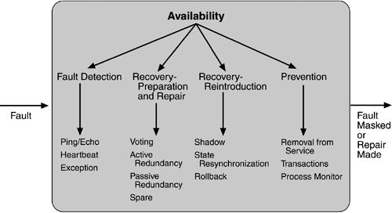
DeSIGN - Advanced
Availability Tactics

Slide 19
DeSIGN - Advanced
Detailed view - Availability
Notes:
Give the audience relevant handout
Explain each term
http://etutorials.org/Programming/Software+architecture+in+practice,+second+edition/Part+Two+Creating+an+Architecture/Chapter+5.+Achieving+Qualities/5.2+Availability+Tactics/

Slide 20
DeSIGN - Advanced
HA underlying platform and Application layer - Case study (explain these modules)
SMF
Application Plane
Active
HM
Standby
Module 1
Module n
Health ping
HM
APP
RM
RM
APP
App RM
Data
Admin
Admin
BM
BM
HA platform
Role
HM
RM
Admin
arbitration
IP based transport bus
-
Abbreviations:
BM
•
HM
Health Manager
•
RM
Replication Manager
•
Admin
Administrator Process
Active System
•
BM
Boot Manager
•
APP
Application
•
SMF
System Mgmt Functionality

Slide 21
DeSIGN - Advanced
Exercise
What availability tactics will be applicable for the running case study
Notes:
For FTP server, data persistence and integrity may be important.
Atleast the connectivity with existing clients should survive the switchover

Slide 22
DeSIGN - Advanced
Maintainability
Goal: ability of the system to undergo changes with a degree of ease.
Ease with which
Bug fixes can be made
New requirements can be met
System can recover from failure
Maintainability increases reliability

Slide 23
DeSIGN - Advanced
Maintainability requirements
Adherence to time specified to to restore the system to its operational status following a failure or removal from operation for an upgrade.
Adherence to specified schedule variance in case of changes made for feature enhancement
Learning curve to maintain the component

Slide 24
DeSIGN - Advanced
Tactics
Modular design, with separation of concerns. Ensuring loose coupling and high cohesion
Plug in modules
Configuration files
Use standardized platform features for addressing themes like security.
Test automation, especially regression
Updated traceability matrix and support documents

Slide 25
DeSIGN - Advanced
Exercise
For the given exercise, identify which of the tactics listed can be implemented, and how
Will you add any dedicated interfaces?
Notes:
FTP server
Change can be – addition of new commands to be run by FTP client, like diff between two files.

Slide 26
DeSIGN - Advanced
Testability
Goal: allow for easier testing when some increment of software development is completed
Enhancing testability not so mature but very valuable
40% of system development
Testing a running system (not designs)
Test harness
SW that provides input to the SW being tested and captures the output
Goal: find faults

Slide 27
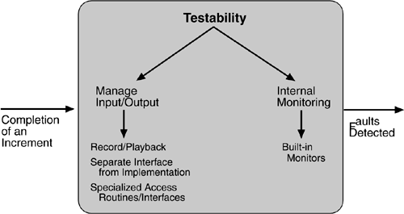
DeSIGN - Advanced
Tactics

Slide 28
DeSIGN - Advanced
Exercise
For the given exercise, identify which of the tactics listed can be implemented, and how
Will you add any dedicated interfaces?

Slide 29
DeSIGN - Advanced
Performance
Goal: to generate a response to an event arriving at the system within some time constraint.
Latency is the time between the arrival of an event and the generation of a response to it
The lesser, the better
After an event arrives, either the system is processing on that event or the processing is blocked for some reason. This leads to the two basic contributors to the response time:
resource consumption
blocked time

Slide 30
DeSIGN - Advanced
Performance – basics
Cover terms around
Concurrency
Significance of multi-core and MT
Throughput
Cache miss, cache coherence
Latency across computation, queues, network

Slide 31
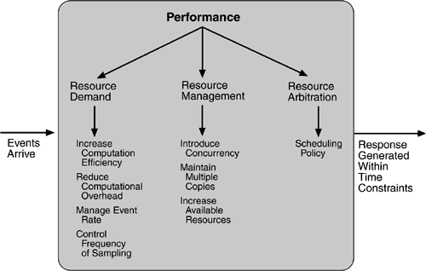
DeSIGN - Advanced
Performance tactics

Slide 32
DeSIGN - Advanced
Exercise
For the given exercise, identify which of the tactics listed can be implemented, and how

Slide 33
DeSIGN - Advanced
Case study + Presentation
Needs teams of 4-5 each
Pick one of the non-functional attributes
Availability
Performance
Testability
maintainability
Design the sub-component diagram, 2 scenario and tactics to implement the non-functional attribute
Present your analysis

Slide 34
Disclaimer
Aricent Group makes no representations or warranties with respect to contents of these slides and the same are being provided “as is”. The content/materials in the slides are of a general nature and are not intended to address the specific circumstances of any particular individual or entity. The material may provide links to internet sites (for the convenience of users) over which Aricent Group has no control and for which Aricent Group assumes no responsibility for the availability or content of these external sites. While the attempt has been to acknowledge sources of materials wherever traceable to an individual or an institution; any materials not specifically acknowledged is purely unintentional

Slide 35
Revision History
Revision no. | Date | Description of change | Author | Reviewed and Approved By
0.1 | 31-dec-13 | Initial set | Shiv Kumar
0.2 | 10-Jan-13 | Updation for correcting sequence | Shiv

